Slide 1

A N S I B L E

Slide 2
Topics :
What is Ansible ?
Why Ansible ?
Ansible Architecture.
How Ansible works ?
Installing & Setting up Ansible .
Basics of YAML - YAML tags .
Creating and Running a playbook .
Variables, Blocks .
Ansible Roles.

Slide 3
What is Ansible ? :
Ansible is an open source community project sponsored by Red Hat, it's the simplest way to automate IT.
Ansible is the only automation language that can be used across entire IT teams from systems and network administrators to developers and managers .

Slide 4
2. Why Ansible ? :
1. Ansible uses Python Language.
2. Ansible’s Playbook uses YAML language.
3. Push Mechanism
4. Agent Less
5. SSH
6. Huge number of Modules.

Slide 5
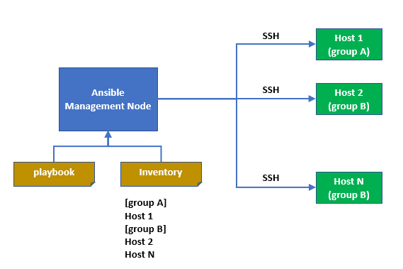
3. Ansible Architecture. :
Architecture of Ansible

Slide 6
1. Ansible Management Node :
The Server on which Ansible is installed.
2. Hosts :
The Servers on which Ansible perform its tasks.
The Connection will be used SSH.
3. Inventory :
This is the file where we mention all hosts.
By default /etc/ansible/hosts file is used by ansible.
We can also create our own inventory files using -i <path> option on the command line.
In which add each hosts in there separate groups.
4. Playbook :
This is an file where we can create our Ansible tasks.
This file is an YAML file.
YAML is a human-readable data-serialization language.

Slide 7
4. How Ansible works ?
1. Ansible works by connecting to your nodes and pushing out small programs, called "Ansible modules" to them. 2. These programs are written to the desired system. 3. Ansible then executes these modules (over SSH by default), and removes them when finished.
Ansible Modules
Removed Modules from Host
Host Machine

Slide 8
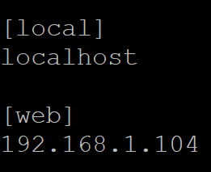
5. Installing & Setting up Ansible :
Install Ansible
$sudo yum install epel-release
$sudo yum install ansible
Configure Ansible
$sudo vi /etc/ansible/hosts
Inventory File
hosts file

Slide 9
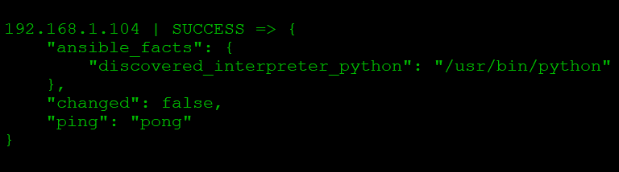
3. Configure Passwordless SSH
$sudo ssh-keygen
$sudo ssh-copy-id root@ipaddress
4. Test Ansible
$ansible web -m ping
- Commandline ansible also know as Ansible Adhoc command

Slide 10
6. Basics of YAML tags :
1. YAML is a human-readable data-serialization language.
2. YAML is stand ‘YAML Ain't Markup Language’.
3. It is like json or any other key-pair structure language.
4 . It is easier for humans to read and write than other common data formats like XML or JSON
1. Key Value Pair
2. Array / List
3. Dictionary / Map
Fruit : Apple
Vegetable : Carrot
Liquid : Water
Fruits :
- Orange
- Apple
Vegetables :
- Carrot
- Cauliflower
Banana :
Fat : 0.4 g
Carbs : 27 g
Grapes :
Fat : 0.3 g
Carbs : 16 g

Slide 11
7. Creating and Running a playbook :
Playbook :
Playbook is is an file where we can create our Ansible tasks.
This file is an YAML file so we need to follow its syntax accordingly.
They are like a to-do list for Ansible that contains a list of tasks. There are different tags some are specified below:
1. name
2. hosts
3. tasks
4. vars

Slide 12
Creating a Playbook to install apache
apache_playbook.yaml
---
- name: Playbook for installing apache
hosts: webservers
tasks:
- name: Tasks Installing apache
yum:
name: httpd
state: latest

Slide 13
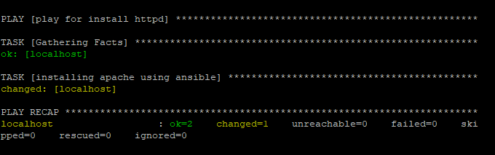
Running a playbook to install apache :
Command to run a playbook: $ansible-playbook install.yaml
Output

Slide 14
8. Variables, Blocks .
Variables :
1. Variable names should be letters, numbers, and underscores. Variables should always start with a letter.
Eg:- foo_part,foo5.
2. YAML also supports dictionaries which map keys to values. For instance:
foo: field1: one field2: two
foo[ 'field1’ ] foo.field1
For Reference Variable

Slide 15
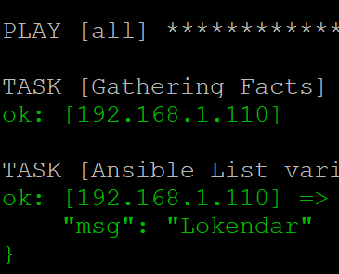
Variables in Inventory
Variables in Playbook
[ Redhat ]
Host1
Host2
[ Ubuntu ]
Host1
Host2
[ Redhat : vars ]
apache_package = httpd
[ Ubuntu : vars ]
apache_package = apache2
- hosts: all
vars:
employee: Lokendar
tasks:
- name: Ansible List variable
debug:
msg: "{{ employee }}"

Slide 16
Blocks :
1. Blocks allow for logical grouping of tasks and in play error handling.
2. Blocks also introduce the ability to handle errors in a way similar to exceptions in most programming languages.
3. Blocks only deal with ‘failed’ status of a task. A bad task definition or an unreachable host are not ‘rescuable’ errors.

Slide 17
8. Ansible Roles :
1. In Ansible, the role is the primary mechanism for breaking a playbook into multiple files. 2. This simplifies writing complex playbooks, and it makes them easier to reuse. 3. Each role is a directory tree in itself. The role name is the directory name within the /roles directory. $ansible-galaxy init role_name 4. This Command will create a role structures. 5. The default structure can be changed.

Slide 18
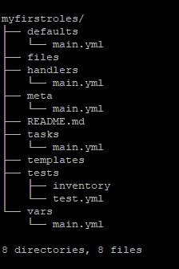
8. Ansible Roles Directory :
1. tasks - contains the main list of tasks to be executed by the role.
2. handlers - contains handlers, which may be used by this role or even anywhere outside this role.
3. defaults - default variables for the role .
4. vars - other variables for the role .
5. files - contains files which can be deployed via this role.
6. templates - contains templates which can be deployed via this role.
7. meta - defines some meta data for this role.

